Slide 1

A Convolutional Neural Network and IoT Based Early Warning System to Prevent Elephant-Train Collisions
MCA Mainproject:
Vaisakh r menon
MCA Rollno:53

Slide 2
CONTENTS
Relevance of the Project
A Description of the project
Existing System and proposed system
Dataset
Algorithm
System Design
Modules

Slide 3
Relevance of Project
One serious facet of the worsening Human-Elephant Conflict (HEC) in nation involves elephant-train collisions.
Endangered Asian elephants are maimed or killed during such accidents, which also often results in orphaned or disabled elephants.
In this project a new concept is explored to develop a technology for prevention of elephant deaths from collisions due to incoming trains.
The CNN was trained using a curated dataset of elephants.

Slide 4
DESCRIPTION OF THE PROJECT
This work proposes the leveraging of recent developments in Convolutional Neural Network (CNN) technology to detect elephants around known hotspots along the railway track. The CNN was trained using a curated dataset of elephants collected on ﬁeld visits to elephant sanctuaries and wildlife parks in Sri Lanka. With this vision-based detection system at its core, a prototype unit of an early warning system was designed and tested.Utilising convolutional neural networks (CNNs) for animal detection has become a more robust option in recent time due to the advances seen in deep learning research. For instance using CNNs for identifying, counting and describing wild animals in camera trap images [10], detecting and tracking wild animals using aerial UAV images and satellite images , have been successfully demonstrated. System uses IR sensor to detect or sense presence of ELEPHANTS AND report it to the online server over IOT.

Slide 5
EXISITING SYSTEM AND PROPOSED SYSTEM
A potential low-cost solution that can aid in these efforts and provide an additional mitigation strategy is the use of low-cost sensors for elephant detection and warning. Utilising convolutional neural networks (CNNs) for animal detection has become a more robust option in recent time due to the advances seen in deep learning research.
Advantages
• More efficient .
• Can detect animals even in the dark.
• Applicable in all whether conditions

Slide 6
DATASET
The system contains pre-trained dataset which is stored in yolov3.weights, which was a advantage of the yolo algorithm and so further training was not needed.

Slide 7
ALGORITHM
YOLOv3 (You Only Look Once, Version 3) is a real-time object detection algorithm that identifies specific objects in videos, live feeds, or images. YOLO uses features learned by a deep convolutional neural network to detect an object. Versions 1-3 of YOLO were created by Joseph Redmon and Ali Farhadi.

Slide 8
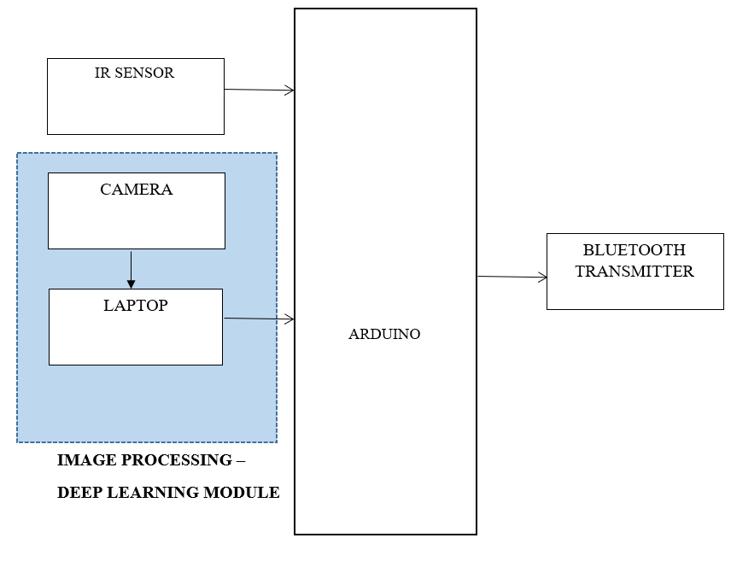
SYSTEM DESIGN
BLOCK DIAGRAM

Slide 9
SYSTEM DESIGN
COMPONENT SELECTIONS
1) ARDUINO UNO-ITS is a microcontroller.
2) IR sensors are now widely used in motion detectors, which are used in building services to switch on lamps or in alarm systems to detect unwelcome guests.
3) Bluetooth transmitter to transmit the message to the receiver.
4) A laptop as image processing module.

Slide 10
MODULES
Image capture module
Image processing module
Message sending module
Working of Modules
Here we detect elephants through various sensors . It is a IR sensor based obstacle detection . On detecting obstacle, image processing module will be activated .Machine learning based Elephant identification is the core of the project. Once elephant detected, information is transmitted through Bluetooth module . The receiver unit at train, receive the information and displays in train unit to notify driver.

Slide 11
THANKYOU!!

